Slide 1
ANIMALS

Slide 2
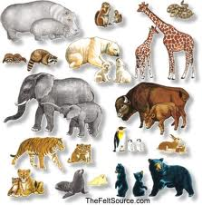
ANIMALS

Slide 3
ANT

Slide 4
ANT

Slide 5
DOG

Slide 6
DOG

Slide 7
CAT

Slide 8
CAT

Slide 9
Cow

Slide 10
Cow

Slide 11
horse

Slide 12
horse

Slide 13
CATS

Slide 15
BIRD

Slide 16
BIRD

Slide 17
BIRDS

Slide 18
BIRDS

Slide 19
FISH

Slide 20
FISH

Slide 21
IGUANA

Slide 22
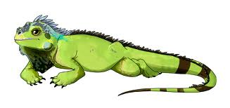
IGUANA

Slide 23
PUPPY

Slide 24
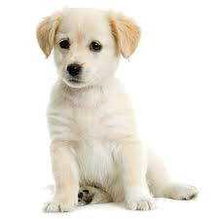
PUPPY

Slide 25
SNAKE

Slide 26
SNAKE

Slide 27
HAMSTER

Slide 28
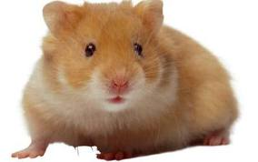
HAMSTER

Slide 29
BOY

Slide 30
BOY

Slide 31
BOYS

Slide 32
BOYS

Slide 33
crane

Slide 34
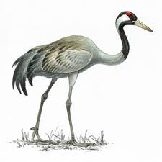
crane

Slide 35
dog

Slide 36
dog

Slide 37
cat

Slide 38
cat

Slide 39
frog

Slide 40
frog

Slide 41
rabbit

Slide 42
rabbit

Slide 43
duck

Slide 44
duck

